Slide 1
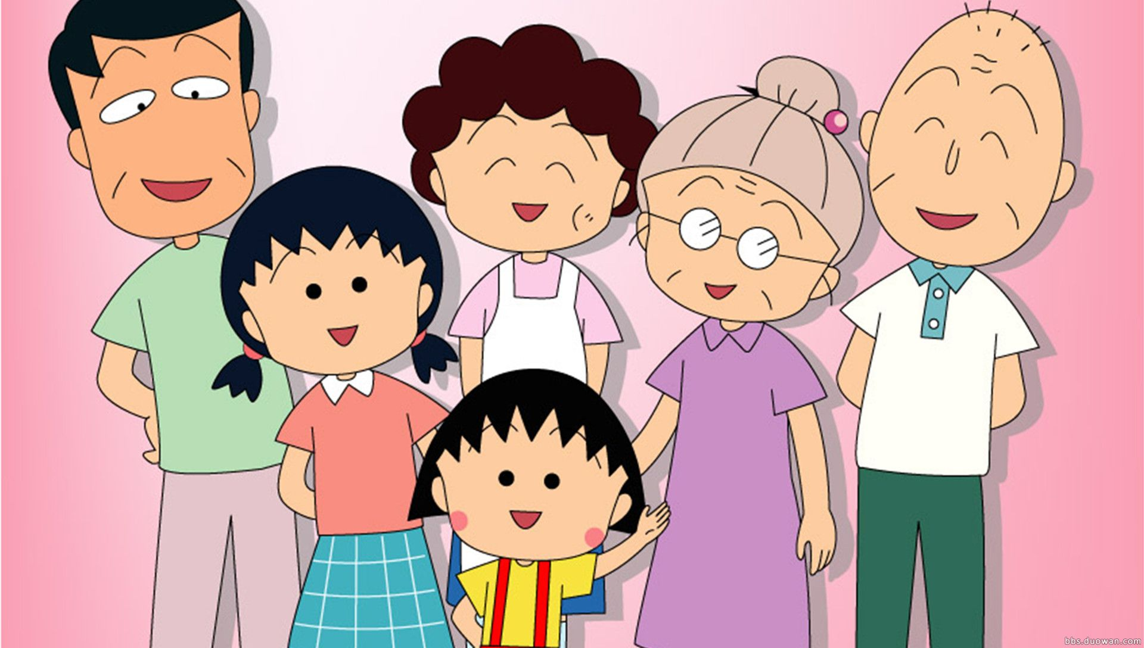
We are family!!!

Slide 2
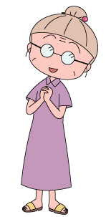
mother
grandma
sister
father
grandpa
me

Slide 3
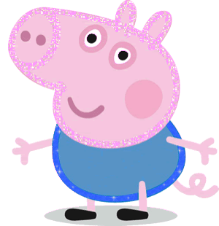
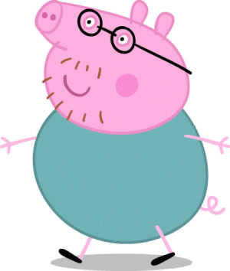
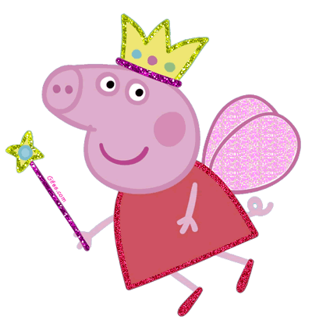
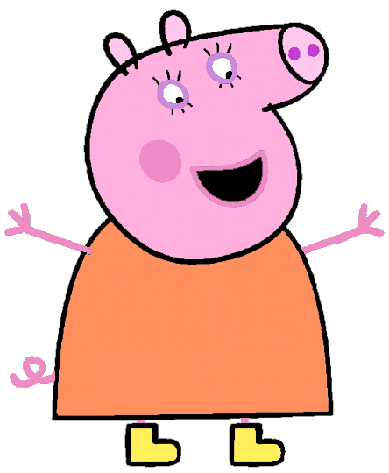
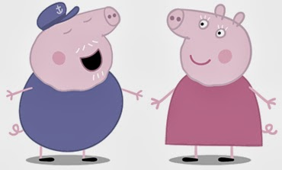
brother
grandpa
father
me
grandma
mother

Slide 4
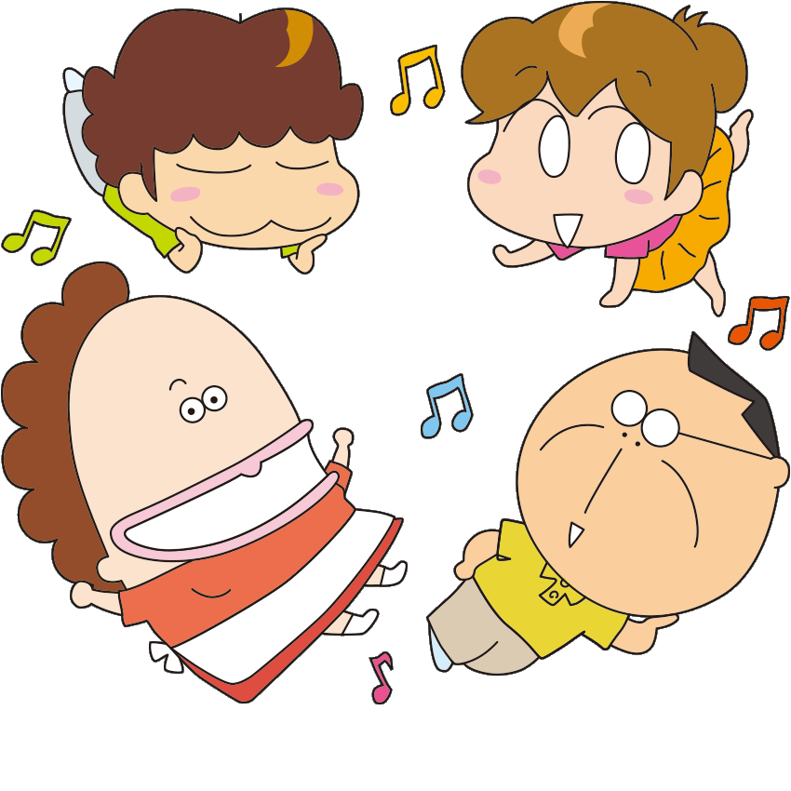
brother
sister
mother
father

Slide 5
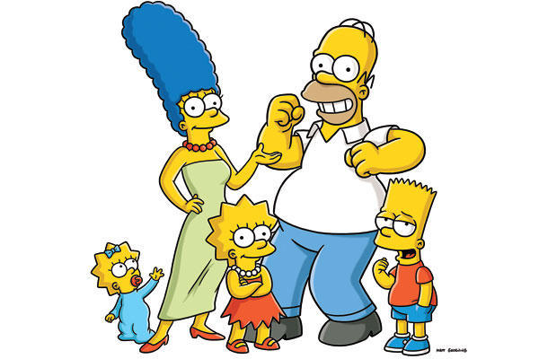
mother
father
younger sister
brother
older sister

Slide 6
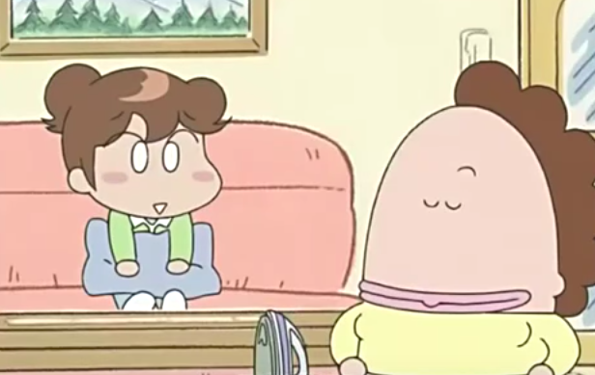
___ my _______.
She’s
mother

Slide 7
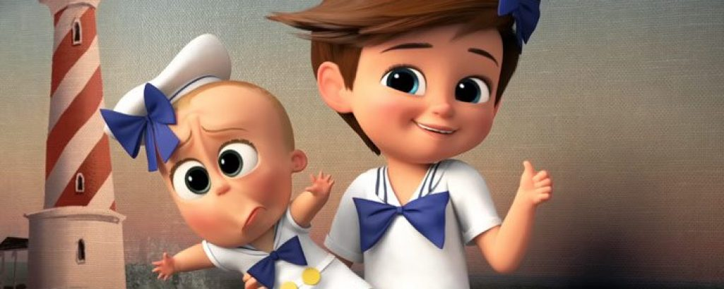
___ my _______.
He’s
brother

Slide 8
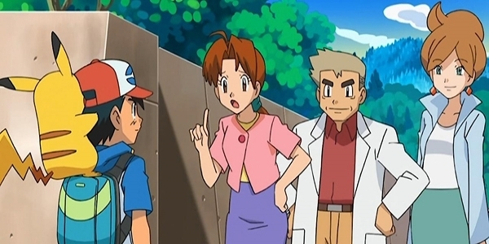
___ my _______.
She’s
mother

Slide 9
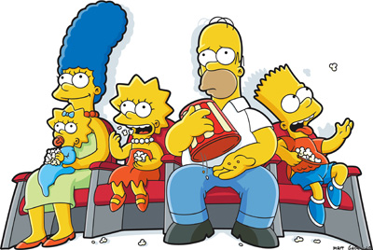
___ my _______.
He’s
father

Slide 10
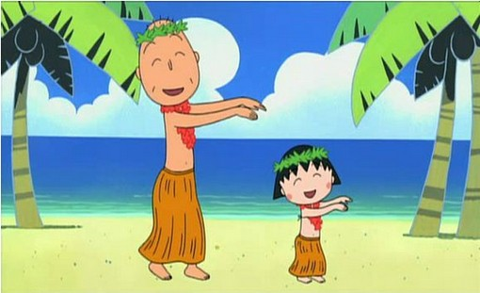
___ my _____.
He’s
grandpa

Slide 11
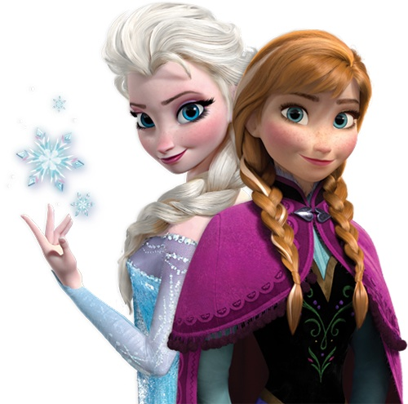
___ my _______.
She’s
sister

Slide 12
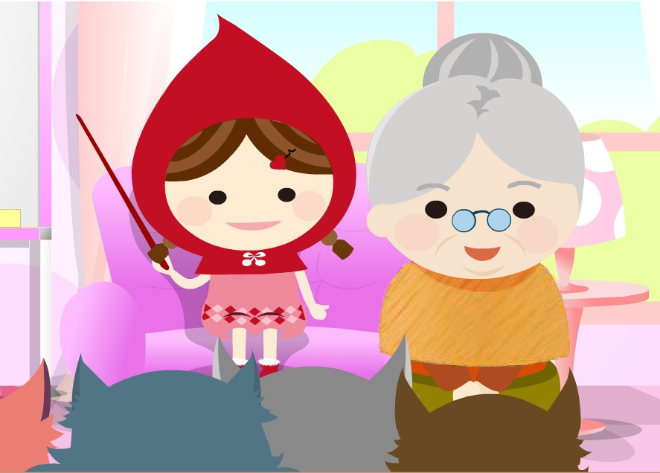
___ my _______.
She’s
grandma

Slide 13
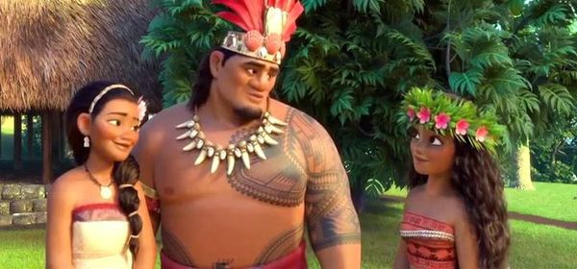
___ my _____.
He’s
father

Slide 14
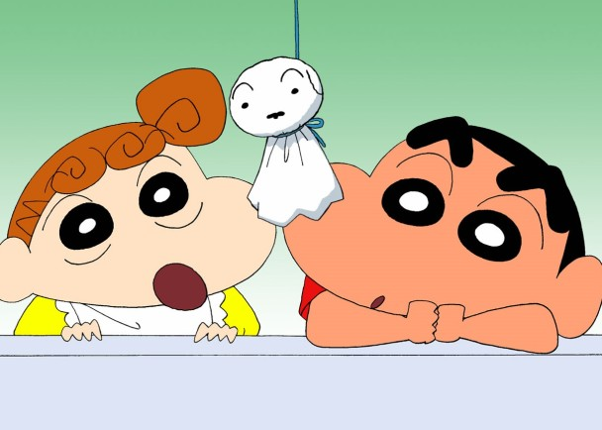
___ my ______.
He’s
brother

Slide 15
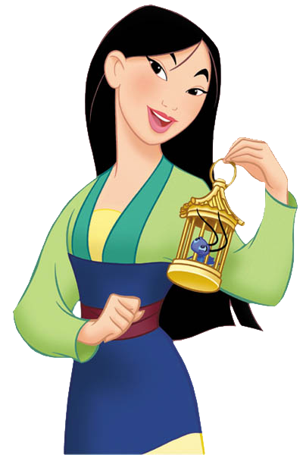
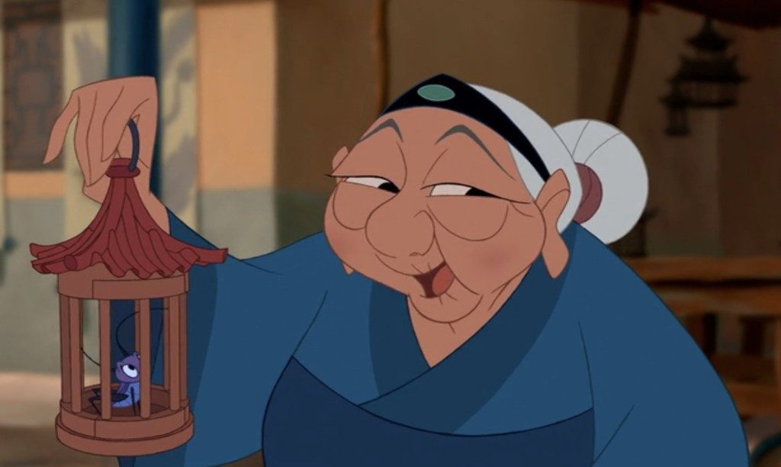
___ my _____.
She’s
grandma

Slide 16
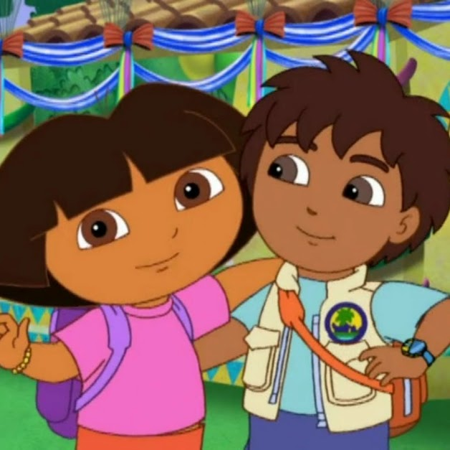
___ my _______.
She’s
sister

Slide 18
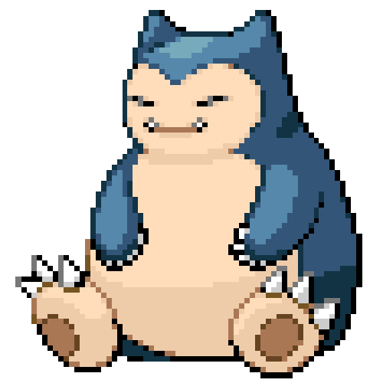
【本週英語作業】
1.聆聽和跟讀英語 CD。
2.完成英語習作P48~P49。
3. 背第3課單字。

Slide 21
I love you as much as……

Slide 22
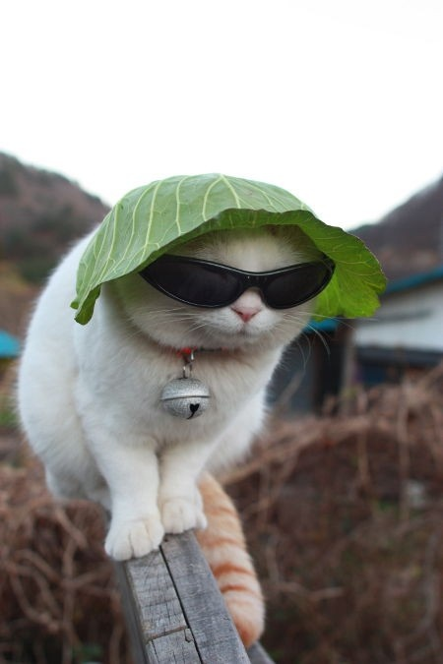

Slide 23
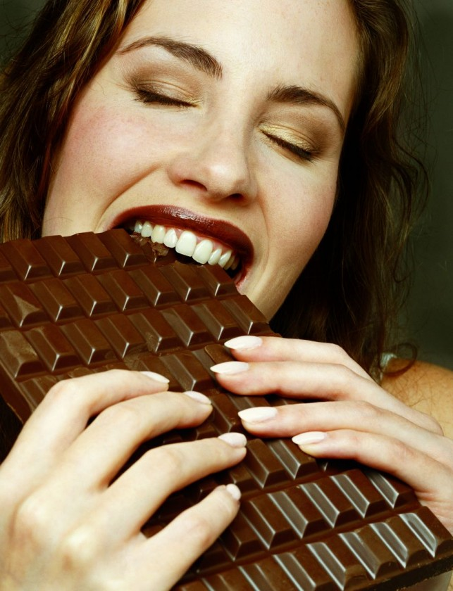
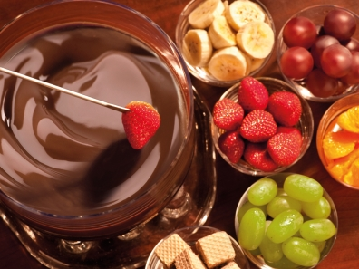
chocolate fondue

Slide 24
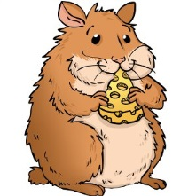
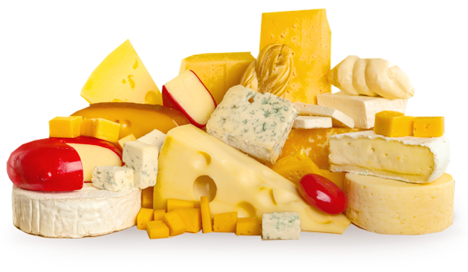

Slide 27
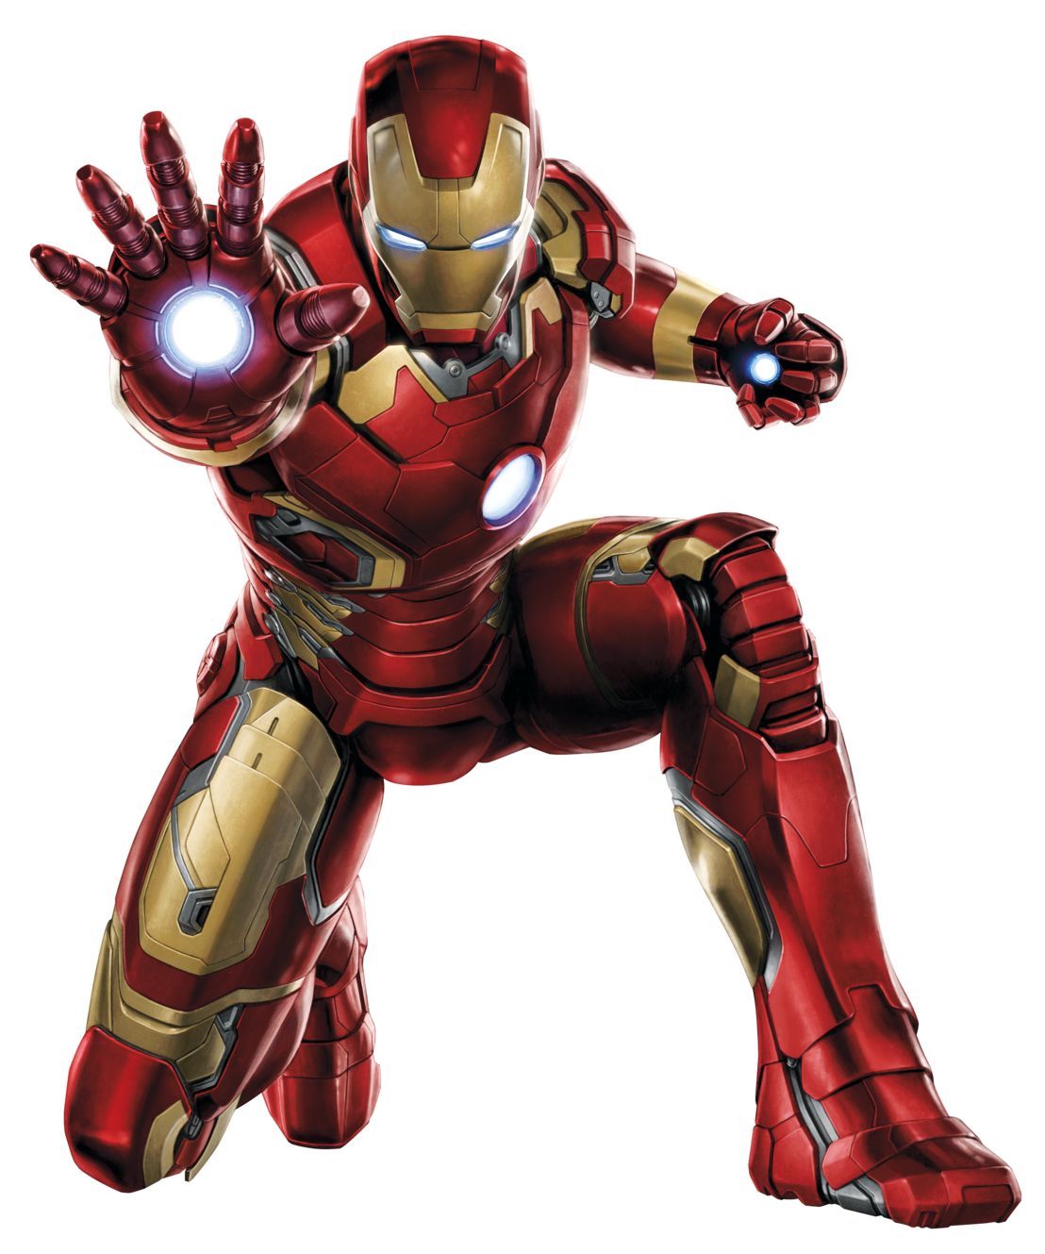
Iron man

Slide 28
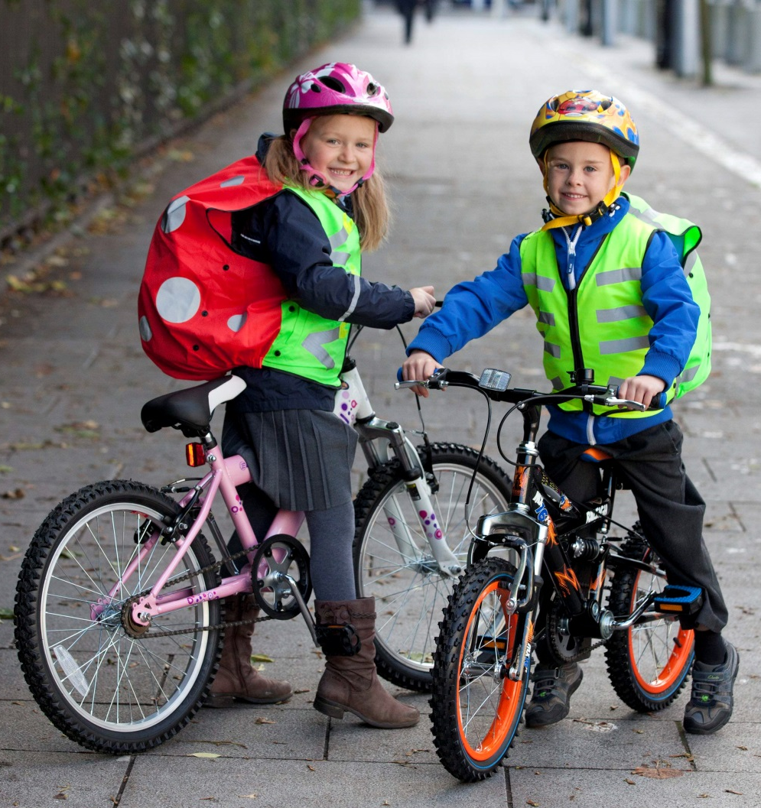

Slide 29
